Slide 1
Predatory Publishers
SOMAC April 6, 2017
Suzanne Maranda
Head Health Sciences Librarian

Slide 2
Do you recognize these titles?
Journal of Preventive Medicine
International Journal of Environmental Research and Public Health
Archives of Medicine
Internal Medicine Review
Preventive Medicine
International Journal of Public Health
Archives of Internal Medicine
Internal Medicine Journal

Slide 3
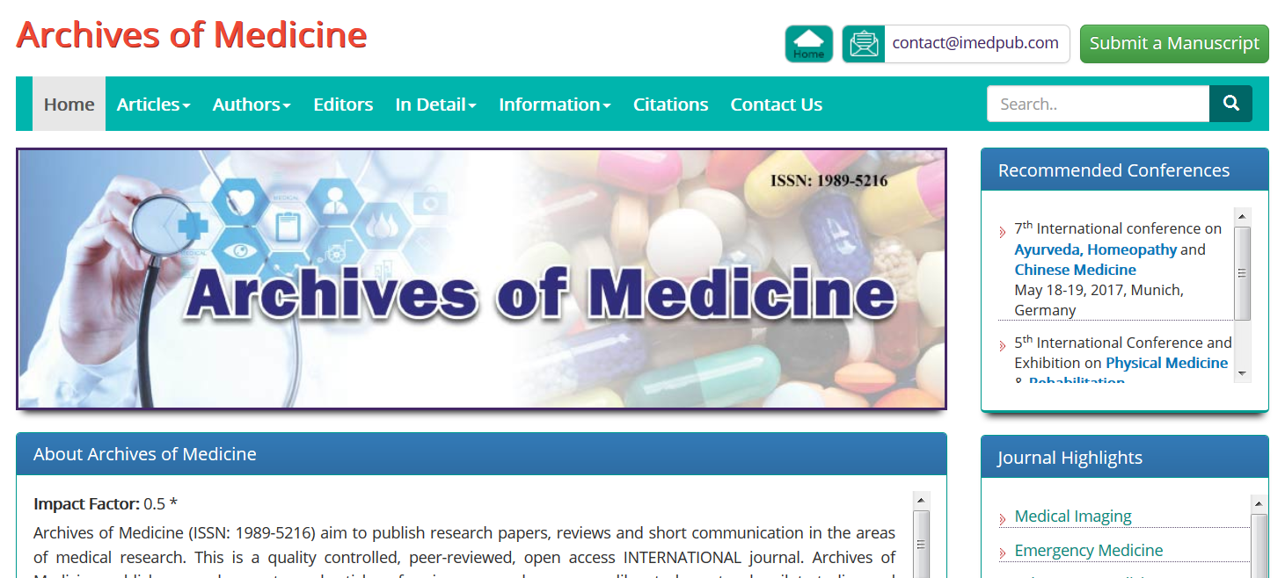
Sample website

Slide 4
Publishing practices
In 2014 publishers launched 1000 new journals
In 2014, 420,000 articles published in predatory journals
The larger predatory publishers purchase legitimate journals or smaller publishers
Some have recently cancelled contracts with OMICS:
Can J Gen Int Med
Can J Optometry

Slide 5
Objectionable practices
Use names on editorial boards without consent or change names on photos (see Ottawa Citizen link)
Invitations to fake conferences
Become members of legitimate organizations such as COPE (Committee on Publication Ethics)
Easily get an ISSN or a fake impact factor

Slide 6
Authors beware
Beall’s Black list has been removed from the Internet
White lists are not reliable:
Anyone can submit articles to PubMed
University libraries purchase journals in bulk
Predatory journals lie about impact factors
They lie about being indexed in Medline/Pubmed
If you try to retract, they will publish anyway and require payment.
Helpful website: thinkchecksubmit.org

Slide 7
Why does it matter?
“I just ignore any unsolicited requests to publish”
BUT:
As co-author, do you know the journal chosen by the PI?
Are you checking references for a faculty position or for a conference keynote speaker?
Are you helping graduate students choose a journal to publish their work?
Are you able to evaluate such papers when you are reading?
Contact: bracken.library@queensu.ca

Slide 8
More information
Gillis, A. Academics beware. University Affairs. 2017;58 (2):19-27.
Shen C, Bjork BC. 'Predatory' open access: a longitudinal study of article volumes and market characteristics. BMC Med [Internet]. 2015;13:230.
QUL guide:
Http://guides.library.queensu.ca/predatory-publications
Ottawa Citizen article:
http://ottawacitizen.com/technology/science/the-editor-is-late-fake-science-journals-hit-new-low

