Slide 1
Assessment and Management of Delirium in Older Adults
Dr. Dallas Seitz and Dr. Agata Szlanta

Slide 2
Objectives
Understand the differential diagnosis and presentation of delirium in older adults;
Review the risk factors and precipitants for delirium; and
Discuss delirium prevention and management strategies.

Slide 3
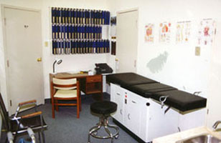

Slide 4
Case 1:
Mr. A: 75 y.o. male, resides with wife
RFV: wife concerned that husband is depressed

Slide 5
HPI:
Recently discharged from KGH following 3 week admission for community acquired pneumonia
Never “fully recovered” physically or mentally since his KGH discharge
Started on antidepressant in hospital for depressive symptoms in hospital, zopiclone to help with sleep
Since discharge:
Napping for most of the day, having some difficulties with sleep at night
Seems disinterested in environment
Wife now having to assist with personal care
Incontinence has worsened and gait is unsteady
Oral intake poor over last week
Speech difficult to understand at times

Slide 6
Past Medical History:
Mild cognitive impairment
CAD with angioplasty
Dyslipidemia
Chronic renal failure
Hypertension
Benign prostate hypertrophy
Depression (recently diagnosed)
Medications:
Citalopram 20 mg po OD
Zopiclone 7.5 mg po QHS
Metoprolol 25 mg PO BID
Rosuvastatin 20 mg PO QHS
Dutasteride 0.5 mg PO QHS
Tamsulosin 25 mg PO OD
HCTZ 25 mg PO OD

Slide 7
Case objectives
Differential diagnosis?
How to you confirm your diagnosis?
Office work-up and management

Slide 8
Triple D
 | Delirium | Dementia | Depression
Onset | Acute | Insidious | Variable
Duration | Days to weeks | Months to years | Variable
Course | Fluctuating | Slowly progressive | Diurnal variation
Consciousness | Impaired, fluctuates | Clear until late in illness | Unimpaired
Attention & Memory | Inattentive, Poor memory | Poor memory without inattention | Difficulty concentrating, memory intact
Affect | Variable | Variable | Depressed, loss of interest and pleasure
CCSMH, Delirium Guidelines, 2006

Slide 9
DSM-IV criteria Delirium
Disturbance of consciousness
Change in cognition, not accounted for by pre-existing dementia
Onset over a short period of time and fluctuating presentation
Evidence from history, physical exam, or lab findings that the disturbance is caused by direct physiological consequences of a general medical condition.

Slide 10
Diagnosing Delirium
Confusion
Assessment
Method
Acute Onset and Fluctuating Course
+
Inattention
+
Disorganized Thinking
Altered Level of Consciousness
OR
Adapted from: Inouye, et al. Ann Intern Med 1990;113:941-948
Notes:
Comments about the sensitivity and specificity of the CAM

Slide 11
Subtypes
Hypoactive
More lethargic, difficult to arouse, minimal speech, slowed motor response
Ddx: depression or dementia
Hyperactive
Restless, agitated, hallucinations, hypervigilance, delusions
Ddx: hypomania mania, psychosis, anxiety disorders, akathisia
Mixed

Slide 12
Pathophysiology

Slide 13
Predisposing Factors/ Vulnerability
Precipitating Factors/ Insults
High Vulnerability
Noxious Insult
Advanced age
Major surgery
Dementia
ICU stay
Severe illness
Multiple psychoactive
medications
Multi-sensory
impairment
Sleep deprivation
UTI
Healthy young person
One dose of
sleeping medication
Low Vulnerability
Non-noxious insult
Adapted from: Inouye and Charpentier, JAMA 1996;275:852-857
Notes:
This is Sharon Inouye’s model of delirium illustrating the interplay of precipitating and predisposing factors in delirium, for example in an elderly person with dementia and perhaps other medical co-morbidities, one dose of sleeping medication or a urinary track infection may be enough to precipitate delirium,
On the other hand a young healthy individual would need to be confronted with a major physiological insult such as a mutli organ trauma or major operation to stress them sufficiently to cause delirium

Slide 14
Predisposing Factors
Age (>65)
Cognitive impairment
dementia is present in up to 2/3 of cases of delirium in the elderly
Male
History of delirium
Sensory impairement
Dehydration
Poor functional status (immobility, falls)
Alcohol abuse
Psychoactive drugs
Multiple medical conditions

Slide 15
Precipitating Factors
Intercurrent illness
Infection, CHF, metabolic abnormality, hypoxia
Prolonged sleep deprivation
Surgery
Environmetal
Restraints, catheter, pain
MEDS, MEDS, MEDS
Sedatives
Narcotics
Anticholinergics
Psychoactives
Histamine-2 blocking agents
Antiparkinsonian
Over the counter (benadryl, gravol)
Chronic meds
polypharmacy

Slide 16
DELIRIUM – multifactorial!
D rugs
E yes, ears
L ow oxygen states (MI, PE, stroke)
I nfection
R etention
I ctal
U nderhydration/undernutrition
M etabolic
S ubudural

Slide 17
Consequences of Delirium
One year mortality of 35-40%.
Associated with worse prognosis
-↑ risk of dementia, institutionalization and death
Underdiagnosed
Prevalence in community:
1-2% in older adults, 14% in > 85 yo
Up to 1/3 of cases are preventable

Slide 18
Persistent Delirium
Systematic review by Cole¹
Substantial number of patients with in-hospital delirium not fully recovered
Worse outcomes: LTC placement, cognition, function and mortality
Time to recovery is variable
 | Discharge | 1 month | 3 mo | 6 mo
Persistent Delirium | 45% | 33% | 26% | 21%

Slide 19
Investigations?

Slide 20
Delirium work up
CBC
Calcium, albumin, Cr, electroylytes, Liver function Tests, glucose
TSH
Urine culture
ECG, blood culture, Chest X-ray, blood gas

Slide 21
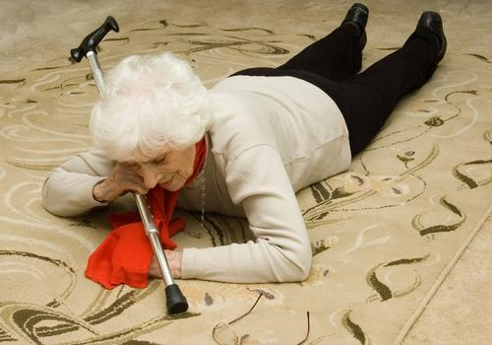
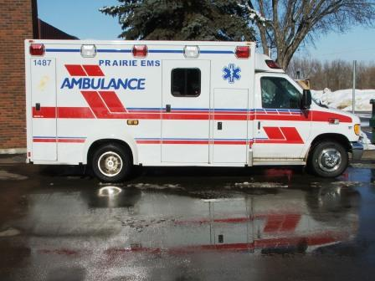

Slide 22
Case 2
Mrs. O.P.
83 year old women lives alone in own home room
Found by paramedics on floor in home after family called police due to no telephone call
Tripped on rug in home fell (?approximately 24 hours)
Pain and bruising over L hip
Vitals: Pulse = 110, BP = 150/95, RR = 16

Slide 23
Past Medical History
Medical Conditions
Medications
HTN
Moderate aortic stenosis
Obesity
Diabetes mellitus II
Osteoarthritis
Hearing Impairment
Urinary incontinence
HCTZ
Insulin
Oxybutynin
Ibuprofen
Tylenol

Slide 24
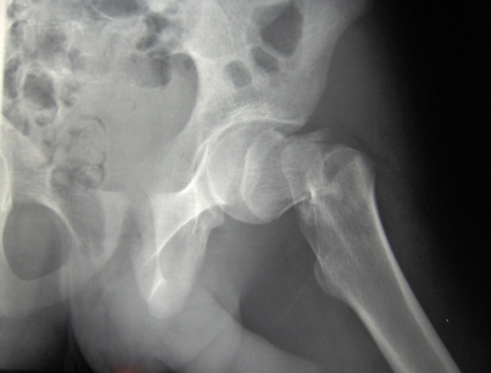
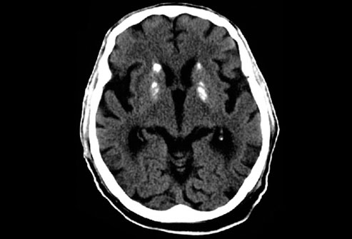
Investigations
Blood Work
Imaging
Hgb = 90
Na²⁺ = 130
K⁺ = 5.0
Cl⁻ = 99
FBG = 12
Creatinine = 95
Urea = 13
eGFR = 40
INR = 1.1

Slide 25
Hospital Course
4 day delay to surgery, NPO in emergency room
Lying on stretcher in hallway
Foley catheter due to limited mobility
Receives general anesthetic for surgery
Undergoes left hip pin and plate
Discharged to orthopedic floor

Slide 26
Questions
What risk factors does Mrs. E.B. have for postoperative delirium?

Slide 27
Postoperative Delirium
Outcomes associated with postoperative delirium:
Functional decline: OR = 2.0
↑ hospital length of stay
Mortality: OR = 2.4
Surgical Procedure | Incidence
Orthopedic | 30 – 50%
Cardiac | 20 – 50%
General surgery | 18%
Urologic | 5 – 10%

Slide 28
Predisposing Factors for Delirium
Demographic characteristics
Advanced age (> 65)
Male sex
Cognitive Status
Dementia
Depression
Past History of Delirium
Functional Status
Immobility
Functional dependence
Low level of activity
History of falls
Sensory Impairment
Visual impairment
Hearing impairment
Nutritional Status
Dehydration
Malnutrition
Medications
Polypharmacy
Psychoactive medications
Alcohol abuse
Medical History
Stroke
Neurological disease
Metabolic diseases
Hepatic or renal failure
Severity of illness
Fracture or trauma

Slide 29
Risk Factors for Postoperative Delirium
 | Relative Risk
Age ≥ 70 | 3.4
Male Gender | 2.0
MMSE < 24 | 4.0
Severity of illness | 4.3
Visual impairment | 3.0
Dehydration (BUN/creatinine ratio ≥ 18) | 2.9
Alcohol abuse | 2.4
Functional impairment | 2.1
Abnormal Na²⁺, K⁺, or glucose | 2.8
WBC > 12 | 2.3

Slide 30
Questions
What interventions could be utilized to prevent postoperative delirium?

Slide 31
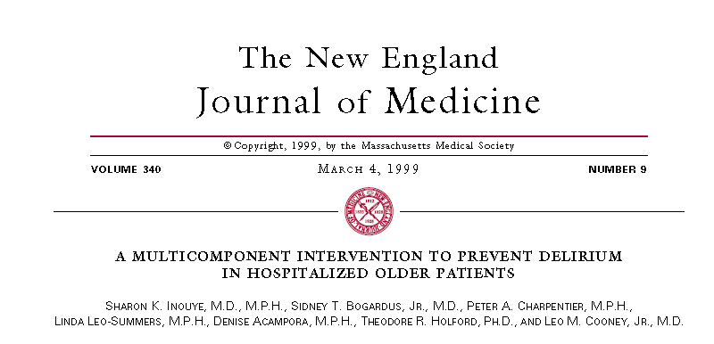
Hospital Elder Life Program
Prevention of delirium through addressing common delirium risk factors:
Cognition
Sleep deprivation
Immobility
Visual impairment
Hearing Impairment
Dehydration
Delirium outcomes:
Incidence: 9.9 vs 15% (OR = 0.6, p=0.02)
Duration and recurrence of delirium also reduced

Slide 32
NICE Delirium Prevention
Ensure providers are familiar with patient, avoid unnecessary transfers within and between wards.
Multicomponent intervention should be used for all individuals including risk assessment within 24 hours.
Intervention should be delivered by multidisciplinary team
Address cognitive impairment by orientation measures, clear signage, clock, calendar, and reassurance.
Ensure adequate oral intake and prevent constipation.
Assess for and treat hypoxia.
Look for and treat infections, avoid catheterization.

Slide 33
NICE Delirium Prevention
Address and minimize immobility through encouragement of walking and/or active range of motion exercises.
Assess and address pain, look for non-verbal signs of pain in individuals with communication difficulties.
Carry out a medication review.
Address poor nutrition and ensure that dentures fit.
Address sensory impairment by resolving reversible causes of impairment and ensure use of aids.
Promote good sleep patterns and hygiene through scheduling of work routines and minimizing noise.

Slide 34
Delirium Rooms
4-bed room within Acute Care of Elderly (ACE) unit
Rationale: provide constant nursing supervision without use of “sitters”, restraints, and minimize use of medications
Staffed by one RPN with shared RN coverage
All patients are visible to RPN, room close to RN station
TADA: tolerate, anticipate, and don’t agitate
No increase in rates of falls, reduction in use of psychotropics to manage delirium symptoms

Slide 35
Pharmacological Interventions
Antipsychotics:
Postoperative ICU patients receiving bolus (0.5 mg IV) + infusion (0.1mg/hour) haloperidol had a lower rate of postoperative delirium (15.3% vs 23.2%)
Low-dose haloperidol (0.5 mg PO TID) reduced severity and duration of delirium but not incidence in hip surgery
Single dose of 1 mg risperidone reduced delirium in cardiac surgery patients
Cholinesterase inhibitors:
3 small RCTs have failed to show any benefit
Gabapentin:
1 small RCT demonstrating benefit (? opioid sparing)

Slide 37
Case 3
Mrs. A.D., 89 y.o. female, resident in LTC facility for 2 years
Nurses ask you to assess as she hasn’t been herself over past two days
Flucuates between being drowsy and restless, yelling out, picking at air, falling out of bed, increasingly difficult to provide care
In Broda chair most of the day now, bed rails up at night to prevent falls
PRN lorazepam ordered by on-call physician

Slide 38
Medications
Donepezil 10 mg 0d
Memantine 10 mg BID
Clopidogrel 75 mg po od
Bisoprolol 5 mg PO OD
Pantoprazole 40 mg po od
Tylenol 1 g TID
Hydromorphone 0.5 mg po BID prn
Lorazepam 1 mg PO BID prn (given twice in last 24 hours)
Past Medical History
Alzheimer’s disease
Last MDS-RAI: Cognitive Performance Scale score: 6
Global Deterioration Scale: stage 7 (non-verbal, bed-bound, incontinent of bowel and bladder)
Stroke
Coronary artery disease
COPD
GERD
Osteoarthritis in both hips (L THR)

Slide 39
What is your differential diagnosis?
Initial investigations?

Slide 40
Delirium Superimposed on Dementia
Prevalence: 22 - 89% of hospitalized and community patients
Accelerates cognitive and functional decline
Underdiagnosed as some behaviours can also occur in dementia
Difficult to diagnosis in advanced dementia

Slide 41
Delirium in Long-Term Care
Prevalence
MMSE ≥ 10: 3.4%
MMSE < 10: 33.3%
Incidence:
MMSE ≥ 10: 1.6/100 person weeks
MMSE < 10: 7/100 person weeks
Risk Factor | Hazard Ratio
Dementia | 2.6
Dementia Severity Minimal Mild Moderate Severe | 1.0 5.1 10.1 9.5
Depression | 2.1

Slide 42
Behavioral Changes and Medical Illness
Symptom | Predictive Value | Liklihood Ratio
Lethargy* | 0.51 | 7.3
Weakness* | 0.50 | 7.0
Decreased appetite* | 0.46 | 6.0
Agitation* | 0.37 | 4.2
Disorientation | 0.31 | 3.2
Dizziness | 0.27 | 2.5
Falls* | 0.23 | 2.1
Delusions | 0.21 | 1.9
Depressed mood | 0.17 | 1.4
Weight loss | 0.17 | 1.4
Aggression | 0.13 | 1.0
*p < 0.05
Boockvar, JAGS, 2003

Slide 43
Acute Medical Illness in LTC
 | UTI | Pneumonia | GI | Cardiac | Dehydration | Other
Boockvar, 2003 | 28% | 18% | 20% | 17% | 8.8% | 8%
Hung, 2010 | 27% | 10% | -- | 16% | 5% | 40%
Alessi, 1998 | 27% | 33%

Slide 44
Management of Delirium
Treat correctable causes
Withdraw all medications contributing to delirium when possible
Start antibiotics promptly
Ensure cardiovascular stability, oxygenation, and electrolyte balance
Ensure hydration and monitor fluid intake and output

Slide 45
Management of Delirium
Assess and monitor nutrition and skin integrity
Indentify and correct sensory deficits
Assess and manage pain using safest interventions
Support normal sleep patterns and avoid use of sedatives

Slide 46
Pharmacological Interventions
Medication | Initial Dosage (mg) | Mean Daily Dose (mg)
Haloperidol | 0.25 – 0.5 mg bid | 1.5 – 5 mg
Risperidone | 0.25 – 0.5 mg bid | 1 – 2 mg
Olanzapine | 2.5 – 5 mg | 5 – 7.5 mg
Quetiapine | 12.5 – 25 mg bid | 50 – 125 mg

Slide 47
Conclusions
Delirium is common among older adults and can have a number of presentations
Management of delirium needs to include a comprehensive review of risk factors and potential precipitants
Prevention and non-pharmacological interventions are cornerstones of delirium care

Slide 48
RESOURCES
Canadian Coalition for Seniors’ Mental Health. The Assessment and Treatment of Delirium. www.ccsmh.ca
CCSMH Pocket Card: Delirium Assessment and Treatment for Older Adults
American Geriatrics Society. Geriatrics at Your Fingertips.
Inouye SK. Delirium in Older Persons. N Eng J Med 2006;354:1157-1165
Journal of the American Geriatrics Society. 2011; Nov Supplement: Advancing Delirium Science: Systems, Mechanisms, and Management

Slide 49
Questions?

